Slide 1
TRAME
Tracce di memoria
Project code: 2020-1-IT02-KA201-079794
BEST PRACTICE Prof.ssa BARBARA ANTONINI
(Liceo Cavour, Rome)
"European multicultural society and citizenship 2012 at Liceo Machiavelli, Rome"
Document produced by: Michela Nocita
Place and date: Rome, 2 July 2021

Slide 2
Prof.ssa BARBARA ANTONINI (Liceo Cavour, Rome) "European multicultural society and citizenship 2012 at Liceo Machiavelli, Rome"

Slide 3
European multicultural society and citizenship for the next generetion"

Slide 4
Key words of the Project
Image from https://api.ndla.no/image-api/raw/Multicultural%20wordle.jpg?width=10720

Slide 5
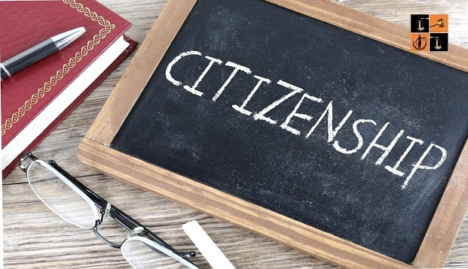
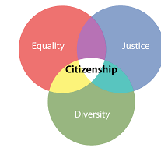
Learning Citizenship at school
https://www.pinterest.it/pin/45528646205837232/
From https://www.pinterest.it/pin/45528646205837232/
Photo form https://www.sundayguardianlive.com/opinion/time-dual-citizenship-india
In compliance with EU General Data Protection Regulation (GDPR) that came into effect on 25 May 2018, we hereby inform you that the personal data you provide to TRAME PROJECT is included in a file managed by PARCO ARCHEOLOGICO DEL COLOSSEO, Piazza di Santa Maria Nova 53, 00186, Roma, as Data Controller, on behalf of the – EU funded project – TRAME project’s partners, and used exclusively for dissemination of professional communications, newsletters, events or promotions organised directly by any of the TRAME project’s partners or by carefully selected third parties. You may revoke the consent you have given us at any time; Likewise, you may exercise your rights of access, rectification, cancellation and opposition free of charge by sending your request accompanied by the copy or data of your Personal Number to the email pa-colosseo.progettotrame@beniculturali.it In order to view our privacy policy and/or information about your Personal Data, the purposes and the parties the Data is shared with, visit the website https://trameproject.eu/ or contact pa-colosseo.progettotrame@beniculturali.it.
The European Commission’s support for the production of this publication does not constitute an endorsement of the contents, which reflect the views only of the authors, and the Commission cannot be held responsible for any use which may be made of the information contained therein. Specific info can be found here.

